Slide 1


—
Administrative Law 2025
Week 5 Tutorial Introduction to Judicial Review
Dr Richard Taylor
Lecturer, School of Law

Slide 2
Agenda
Hypothetical
What is Judicial Review
01
02
Get your thinking about a problem to be solved
Overview of key points
JR in Common Law
ADJR Act
03
04
Common law development of judicial review.
Statutory intervention in JR
Justiciability
Problem Questions
05
06
What issues are suitable for JR
Questions to prepare for assessment
Notes:
Australia no bill of rights
Extra important admin law often only avenue of redress

Slide 3
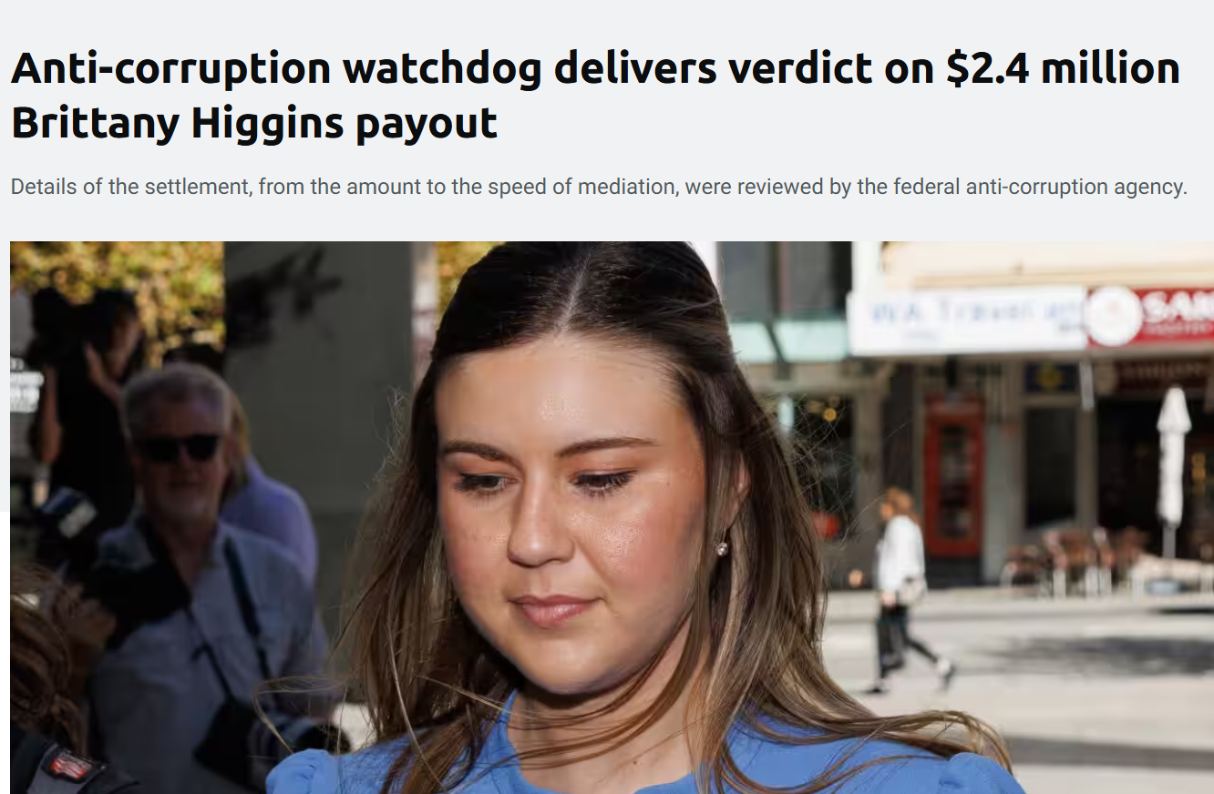
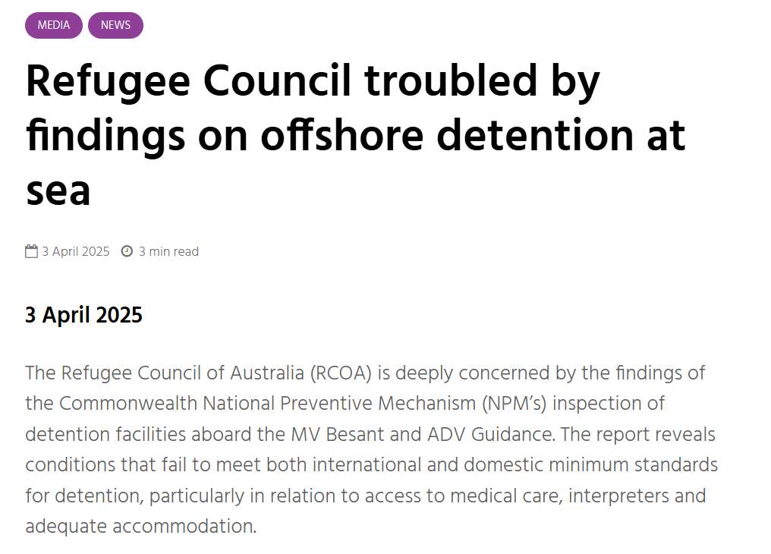

Administrative Law in the News [To be updated each week]
Anti-corruption watchdog delivers verdict on $2.4 million Brittany Higgins payout | SBS News
Refugee Council troubled by findings on offshore detention at sea
Victoria receives the most Freedom of Information requests in Australia, and the system is buckling - ABC News
Administrative Law –LAW1023

Slide 4


(Not so) Hypothetical
You work for a critical minerals project in north-eastern Victoria. The mining project would produce large quantities of antimony which is used in semi-conductors and other high-end electronics. Outside of North Asia there is relatively little production. You have spent 8 years getting all of the permitting in place and $20m of shareholders funds. Resources Victoria has indicated the project meets necessary technical and environmental objectives. After a change in government, the incoming minister declares they find the project not in Victoria’s state interest (they campaigned against it) and petition the Governor to remove the area from the Mineral Resources Act 1990. Simultaneously, the Federal Minister for the Environment and Water refuses EPBC approval for not addressing the impacts on migratory birds (no migratory birds had been identified in the area).
What, if any, avenues of judicial review are available to you?
Underground Portal entrance
Administrative Law –LAW1023

Slide 5
Questions
1. How, broadly, would you describe what judicial review is?
2. What kinds of things are subject to judicial review?
3. What are the three avenues of judicial review?
a. In what ways are these not wholly separate?
b. How does s 39B of the Judiciary Act 1903 (Cth) operate?
4. What are the advantages/disadvantages of judicial review?
a. Where is the power to conduct judicial review derived from?
5. How does merits review differ from judicial review?
a. Why are these things so often considered in tandem?
6. What is the original jurisdiction of the High Court? Hint: s75 of the Constitution
Notes:
Australia no bill of rights
Extra important admin law often only avenue of redress

Slide 6
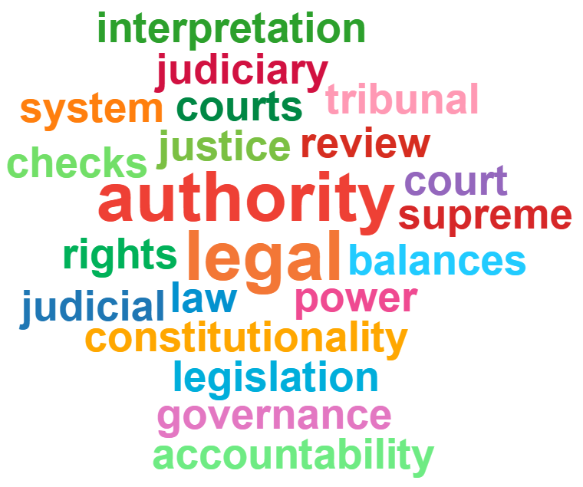
Types of Judicial Review
Judicial control over administrative action is about the supervisory role of courts over government and who has the final say when there are disputes over interpretation/application of the law.
There are 3 types of judicial review
1. Common law;
2. Constitutional; and
3. Statutory – i.e. Administrative Decisions (Judicial Review) Act 1977 ( Cth) – aka ADJR Act
Administrative Law –LAW1023

Slide 7
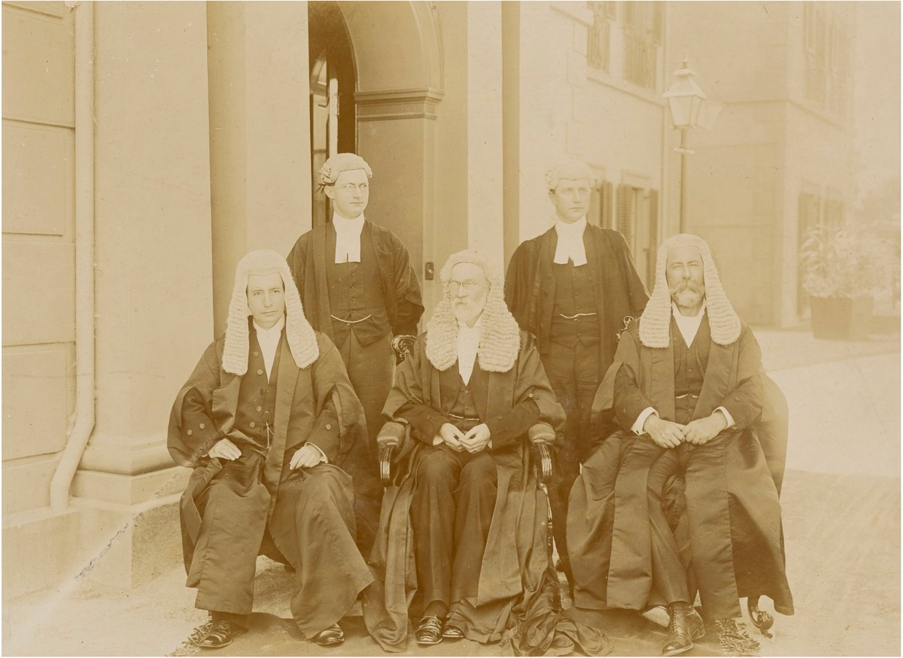
Judicial Review – Grounds of Review
Ultra vires
Improper purpose
Unreasonableness
Uncertainty
Unlawful delegation
Failure to consider a relevant consideration
Denial of natural justice/procedural fairness
Hearing
Bias
Jurisdictional error
Error of law on the face of the record
Case image?
First High Court of Australia: Source: National Portrait Gallery
Administrative Law –LAW1023

Slide 8
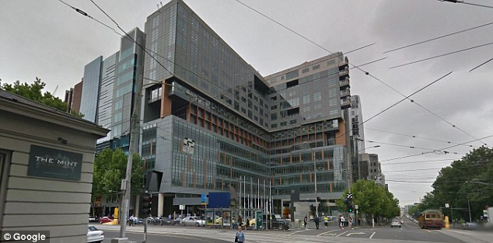
Judicial review – Federal Court jurisdiction
Section 39B(1) of the Judiciary Act 1903 (Cth) provides
“Subject to subsections (1B), (1C) and (1EA), the original jurisdiction of the Federal Court of
Australia includes jurisdiction with respect to any matter in which a writ of mandamus or
prohibition or an injunction is sought against an officer or officers of the Commonwealth.”
Section 44 (1A) also provides for jurisdiction over matters ‘arising under any laws made by the
Parliament’ and s 44(2A) of the Judiciary Act allows HCA to remit any case it is able to hear to the
Federal Court
Original jurisdiction of these courts is available even when ADJR Act review is unavailable/excluded
Administrative Law –LAW1023

Slide 9
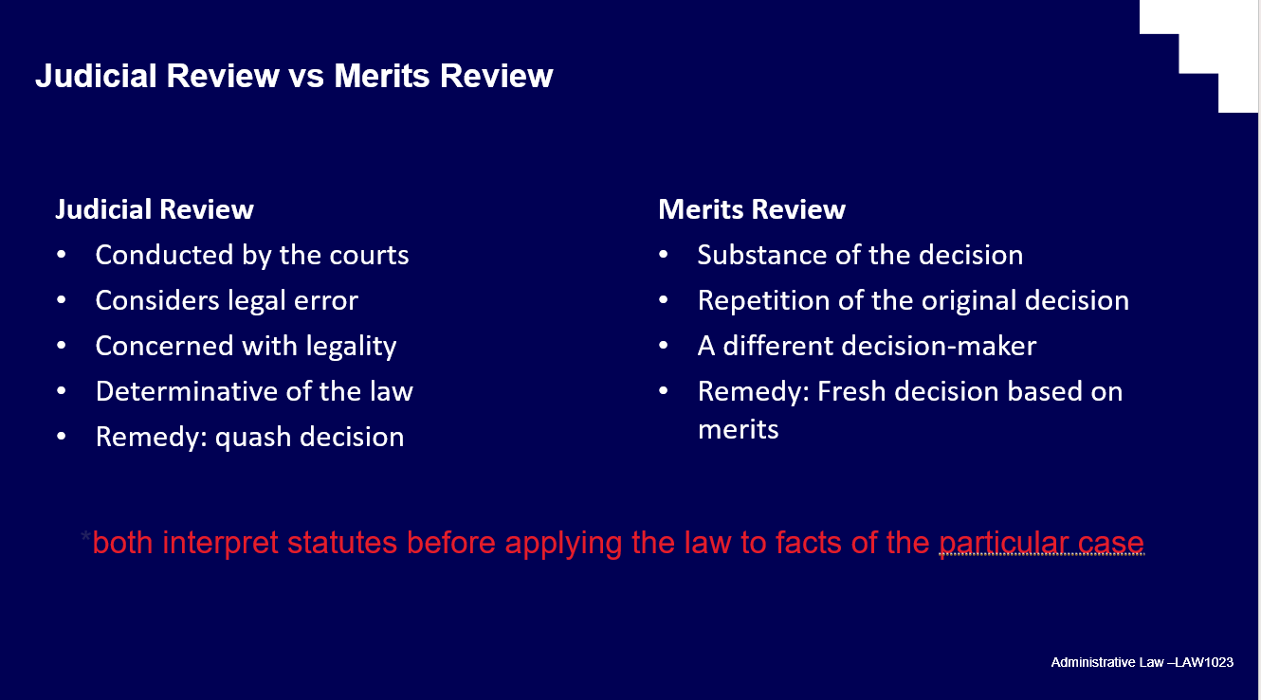
Judicial Review vs Merits Review
This is not merits review – i.e. putting court or tribunal in shoes of the decision maker.
Judicial review makes sure the decision is not ‘tainted’ in some way
  Was this decision within the Minister’s power?
  Was it invalid due to an irrelevant consideration?
Judicial review looks at the legality of the decision i.e. whether it was made according to the law and not whether it was the right or preferable decision.
Recall Slide from week 4
Administrative Law –LAW1023

Slide 10
Questions
6. What are the advantages of statutory judicial review under the Administrative Decisions (Judicial Review) Act 1977 (Cth) (‘ADJR Act’)?
7. What are the three things that must be demonstrated under s 3 of the ADJR in order for its jurisdiction to be enlivened?
8. What is a decision for the purposes of ADJR?
Notes:
Australia no bill of rights
Extra important admin law often only avenue of redress

Slide 11
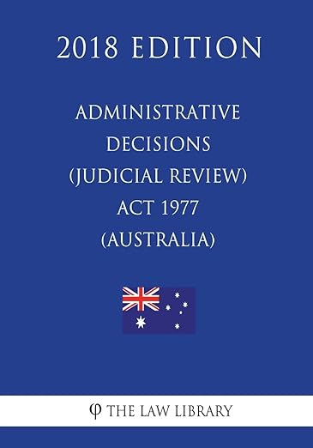
Statutory judicial review – legislation
ADJR Act codifies and simplifies the common law and constitutional review – systems sit in parallel
ADJR Act provides an alternative method of judicial review with following advantages:
  Right to reasons (s 13)
  Less complex procedures (ss 11, 15, 15A)
  More flexible remedies (s 16)
If statutory review not available, may still be able to make original jurisdiction application
Administrative Law –LAW1023

Slide 12
ADJR Act – Section 3 - Interpretation
decision to which this Act applies "means a decision of an administrative character made, proposed to be made, or required to be made (whether in the exercise of a discretion or not and whether before or after the commencement of this definition):
(a) under an enactment referred to in paragraph (a), (b), (c), (d) or (e) of the definition of enactment ; or
(b) by a Commonwealth authority or an officer of the Commonwealth under an enactment referred to in paragraph (ca), (cb) or (f) of the definition of enactment ;
other than:
(c) a decision by the Governor - General; or
(d) a decision included in any of the classes of decisions set out in Schedule 1.
Administrative Law –LAW1023

Slide 13
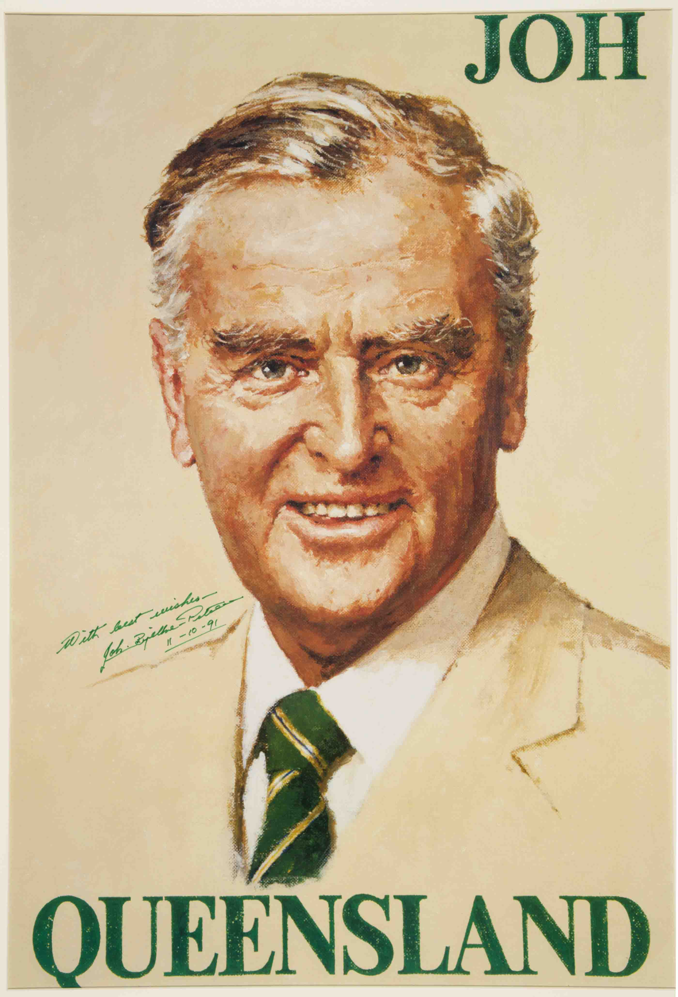

ABT v Bond (1990) 110 CLR 321
Before this case ‘decision’ and conduct were given broad construction, resulting in broad jurisdiction under ADJR Act –Bond investigated by ABT as someone who might not be ‘fit and proper person’ to hold broadcasting licence – had made public statements suggesting bribery and threats
ABT published interim ‘Decision on Facts’ concluding that Bond (and, by extension, his companies who actually held the licences) was not a fit and proper person. No action yet taken eg to cancel or modify licences.
Bond sued ABT under ADJR Act in respect of 11 decisions and 7 instances of conduct
ABT argued that only 1 – the ‘not fit and proper’ finding – met ADJR Act definition
HCA points out that subsections 3(2), 3(3) and 3(5) and indeed s 6 would be unnecessary if Parlament had not meant ‘decision’ to be interpreted relatively narrowly
Concluded that ‘decision’ must be ‘substantive’ and ‘final or operative and determinative’
‘Conduct’ refers to administrative activity preceding a decision that reveals a
flawed administrative process
In this case, findings wrt licencees were ‘decisions’, finding wrt Bond was not,
but NB findings of fact generally not ‘decisions’ – )
Case concerned Bond’s settlement payment to Sir Joh: Campaign Poster: Source: Queensland Museum
Administrative Law –LAW1023

Slide 14

Edelsten v HIC (1990) 96 ALR 673
Edelsten investigated under Health Insurance Commission Act 1973 for claiming excessively under Medicare
Sued Commission after HIC advisers Drs Nearhos and Dash conducted factual investigations and referred the matter to a disciplinary committee respectively
Full Federal Court held that decisions which ‘have real impact upon a person’s rights, privileges or obligations’ should pass Bond test, whereas others will be ‘mere stepping stones which lead ultimately to the making of a decision which does not affect the person’s position’
Administrative Law –LAW1023

Slide 15

Kelson v Forward (1995) 60 FCR 39
Merit Protection and Review Agency (MPRA) had power to inquire into and report to Minister about Commonwealth Government employment issues.
Conducted inquiry into workplace harassment at the War Memorial and reported to Minister
Director of War Memorial sued claiming breaches of natural justice and incorrect test of ‘harassment’
Federal Court held – NB after Bond – that the report was a reviewable ‘decision’ – stood alone as a ‘separate and discrete decision’ and did not ‘fragment’ the admin process; report was had ‘real impact’ on rights and was ‘substantive’ (citing Bond and Edelsten)
Administrative Law –LAW1023

Slide 16
Questions
9. Consider Australian Broadcasting Tribunal v Bond (1990) 110 CLR 321
a. What were the facts?
b. What was held?
10. What does it mean for a decision to be of an administrative character?
11. What is the difficulty with defining a decision as under an enactment?
Notes:
Australia no bill of rights
Extra important admin law often only avenue of redress

Slide 17

Federal Airports Corporation v Aerolineas Argentinas (1997) 147 ALR 649
Federal Airports Corporation was empowered to impose charges on those using airports
AA challenged a landing fee for large aircraft
Since rule was ‘of general application’ – FAC contended that it was legislative in character rather than administrative
FAC’s hybrid govt/commercial nature was key consideration for Court
Concluded that the determination of a landing fee was part of the ‘execution or administration of the FAC Act’
Administrative Law –LAW1023

Slide 18

Roche Products Pty Ltd v National Drugs and Poisons Schedule Committee (2007) 163 FCR 451
TGA gave National Drugs & Poisons Schedule Committee to determine which substances should be listed on the Poisons Standard – incl. in Appendix H drugs which could be sold over the counter (and advertised for direct sale)
Committee decided to remove weight control drug Orlistat from the relevant Appendix after complaints that it had been promoted on Australian Idol
Fed Court held that the decision of the Committee to amend Appendix H was of a legislative character (ie not reviewable under ADJR Act)
  ‘The distinction is essentially between the creation or formulation of new rules of law having general application and the application of those general rules to particular cases’ (citing Cth v Grunseit (1943) 67 CLR 58)
Listed relevant factors incl. that rule applied to the substance behind Orlistat regardless of mfr; Poisons Standard was part of national legislative scheme; decisions of Committee gazetted and not subject to merits review etc (see further tb [2.4.40C])
Consequence, due to lack of listing on FRLI, was invalidation of Standard! [2.4.41]
Administrative Law –LAW1023

Slide 19
Questions
12. Consider Griffith University v Tang (2005) 221 CLR 99
a. What were the facts?
b. What was held?
13. What is a privative clause?
14. What is justiciability?
a. When does it apply?
Notes:
Australia no bill of rights
Extra important admin law often only avenue of redress

Slide 20

Griffith University v Tang (2005) 221 CLR 99
S 3 def. of ‘enactment’ = Commonwealth Act and any instrument made under such an Act
How broad is ‘instrument’ though?
Ms Tang, postgrad student, challenges decision made by Uni committee that she had engaged in academic misconduct (falsified data for PhD) and ending her candidature
HCA held that the decision to terminate her candidature was not made under the Griffith University Act 1998 or university statutes; rather under a policy on misconduct
Test adopted by HCA is that a decision will only be ‘made under an enactment’ for ADJR purposes if it ‘derive[d] from the enactment the capacity to affect legal rights and obligations’ or ‘took its legal force or effect from statute’
NB power to make the decision can be implied by the enactment; need not be express
Court noted that relationship between Tang and the university was ‘voluntary’ and involved no contractual relationship – decision made eg to fire an academic would be different.
Administrative Law –LAW1023

Slide 21
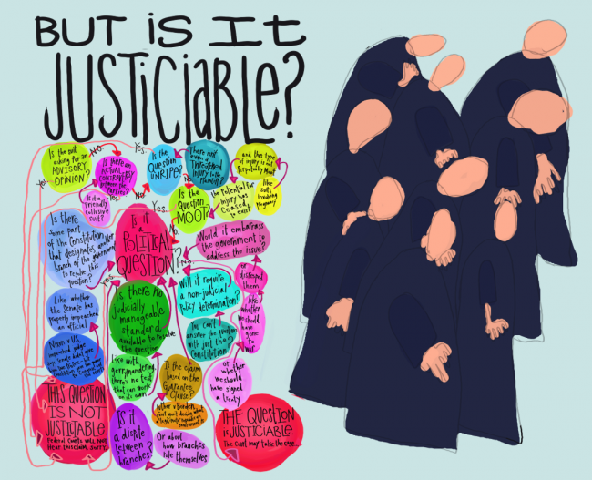
Justiciability
Ask: 1. Can the court resolve the conflict?
2. Should the conflict be resolved by the
court?
When: 1. What is the status of the decision maker?
2. What is the source of the power exercised?
3. What is the nature of the power?
4. What is involved in the exercise of that power?
Administrative Law –LAW1023

Slide 22

Justiciability
Is it appropriate for the courts to review any government decision?
Under s 75, the High Court (& by extension other Ch III courts) can only resolve ‘matters’ – what does this mean? See eg Re McBain; Ex Parte Catholic Bishops’ Conference (2002) 209 CLR 372 ‘justiciable controversy between the parties’ – also related to standing (Topic 6)
Typical exclusions:
Exercise of prerogative power; made by cabinet; close relationship with national security; made in the conduct of international relations and ‘operational’ decisions
These exclusions are not blanket ones though – see following cases:
Hicks v Ruddock (2007) 156 FCR 574
Re: McBain; Ex-parte Australian Catholic Bishops Conference (2002) 209 CLR 372
Minister for Arts, Heritage and Environment v Peko-Wallsend (1987) 15 FCR 27
Administrative Law –LAW1023

Slide 23
Questions
15. What kinds of things are typically excluded from the court’s jurisdiction as being non-justiciable?
16. Consider Re: McBain; Ex-parte Australian Catholic Bishops Conference (2002) 209 CLR 372
a. What were the facts?
b. What was held?
c. Why is this case relevant for questions of justiciability?
Notes:
Australia no bill of rights
Extra important admin law often only avenue of redress

Slide 24
Questions
17. What is a jurisdictional error?
18. Why is it important?
19. For which avenues of review is jurisdictional error most important?
a. Why?
20. What kinds of things are considered jurisdictional errors?
21. What are the constitutional implications of jurisdictional error?
a. How has this changed after Kirk v Industrial Court (NSW) (2010) 239 CLR 531
22. Why is it so important to determine if an error is a jurisdictional error?
Notes:
Australia no bill of rights
Extra important admin law often only avenue of redress

Slide 25
Common Law Judicial Review
In addition, to the common law s 75(v) of the Constitution provides for an ‘entrenched minimum provision’ of judicial review. Section 75 (v) Australian Constitution sets out the original jurisdiction of the High Court to grant a writ of mandamus, prohibition or an
injunction.
Also see S. 32 Judiciary Act 1903 (Cth) re HC power
Section 39B(1) of the Judiciary Act 1903 (Cth) (Judiciary Act) extends the original jurisdiction of the High Court of Australia (High Court) to the Federal Court of Australia (Federal Court).
Section 39B(1A)(c) vests the Federal Court with jurisdiction over ‘any matter arising under any laws made by the Parliament, other than a matter in respect of which a criminal prosecution is instituted or any other criminal matter’.
Question: Discuss the role played by the prerogative writs in the area of judicial review. To which type of review do they relate?
Notes:
Australia no bill of rights
Extra important admin law often only avenue of redress

Slide 26
Judicial Review v Merits Review
The High Court has stood firmly against intruding into the merits of decisions.
Judicial Review is confined to an error of law.
The High Court takes a narrow view of the ground of error of law which is most likely to stray into merits review: Associated Provincial Picture Houses Ltd v Wednesbury Corporation
Notes:
Australia no bill of rights
Extra important admin law often only avenue of redress

Slide 27

Associated Provincial Picture Houses Ltd v Wednesbury Corporation
Facts: An English law provided that cinemas could only open on Sundays with permission from the local authority.
Associated Provincial Picture Houses (Associated) applied for permission.
Permission was granted, but only provided that no children under the age of 15 was admitted.
Associated appealed arguing that the decision was unreasonable.
Issue:
Could the Court overturn the decision because it was unreasonable?
Held:
The Court held that it could not intervene because it can only do so where the decision maker has gone beyond their legal powers.
This means the court can only intervene in cases where:
The decision maker has not considered matters that lawfully must be considered;
The decision maker has considered matters that are not relevant; or
The decision was so unreasonable that no reasonable person could have made it.
Former Wednesbury Cinema (Source:Wikicommons)
Notes:
Australia no bill of rights
Extra important admin law often only avenue of redress

Slide 28
Associated Provincial Picture Houses Ltd v Wednesbury Corporation
The third limb – that the decision was “so absurd that no sensible person could ever dream that it lay within the powers of the authority” [229] has become known as Wednesbury Unreasonableness.
In this particular case, whether or not the Court thought the condition was fair or the best outcome was irrelevant – it is only relevant whether it was lawful, and it was. This was because the Parliament wants the decision maker to make the decision, not the Court. Therefore Associated’s case failed.
This case therefore shows that a Court can only intervene in very limited circumstances. This is what is known as “judicial review”.
Former Wednesbury Cinema (Source:Wikicommons)
Notes:
Australia no bill of rights
Extra important admin law often only avenue of redress

Slide 29
ADJR Act
In addition to its common law jurisdiction, the Federal Court also has statutory jurisdiction to undertake judicial review pursuant to the ADJR Act. the conferring of this jurisdiction on the Federal Court itself had a significant effect on the development of judicial review, including common law judicial review.
ADJR Act codifies and simplifies the common law
The ADJR Act did three important things:
1. It removed the technical requirements of the prerogative writs - review was available for error of law simpler. The remedies available were expanded.
2. It set out in simple terms the grounds which would establish error of law (ss 5 & 6).
3. It imposed an obligation on most decision-makers to give reasons for their decisions (s 13).
If statutory review not available, may still be able to make original jurisdiction application
Notes:
Australia no bill of rights
Extra important admin law often only avenue of redress

Slide 30
ADJR Act - Questions
What is the importance of the provisions of ss 32 and 44(2A) of the Judiciary Act 1903 (Cth)? Discuss and explain.
Discuss the provisions of ss 3,5,6,7,10,15 and 16 of the Administrative Decisions (Judicial Review) Act 1977 (Cth) and the role they play in statutory judicial review.
What is the difference between a judicial decision and an administrative decision?
Notes:
Australia no bill of rights
Extra important admin law often only avenue of redress

Slide 31
—
Questions?
Email
richard.taylor2@rmit.edu.au

